Slide 1


Analysing and Predicting Netflix Titles Using AI/ML Models

Slide 2
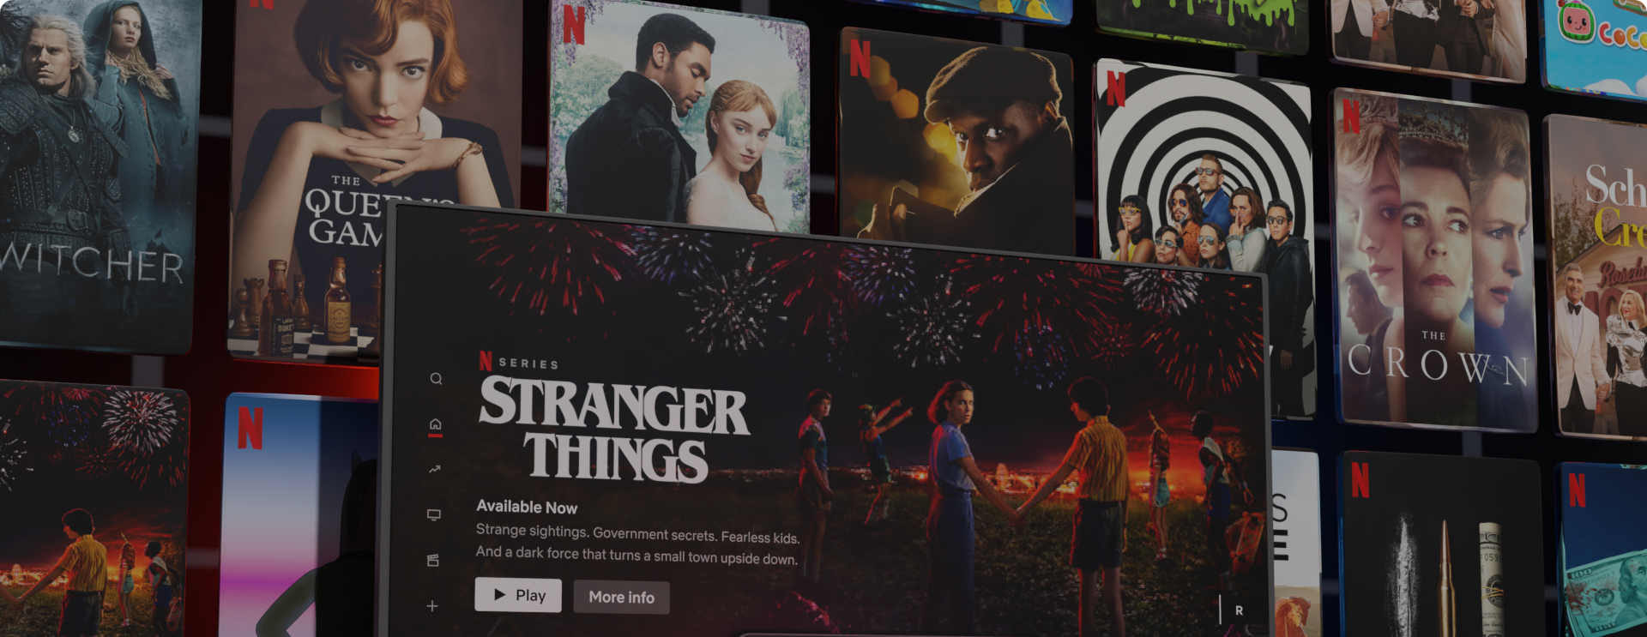
Objective:
- To analyse Netflix TV shows and movies dataset.
- To build predictive models to gain insights and make recommendations.
- Scope:
- Exploratory data analysis.
- Predictive modeling using AI/ML techniques.
- Visualization of trends and patterns.

Slide 3
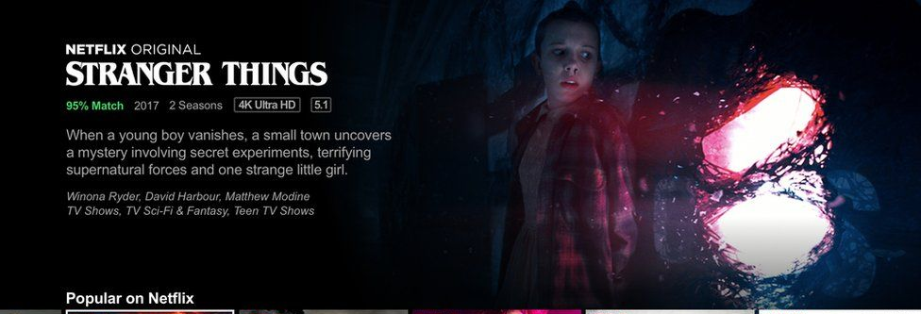
Why Analyse Netflix Titles?
- Popularity and Relevance:
- Netflix is a leading streaming service with a vast library of content.
- Business Insights:
- Understanding trends and user preferences can drive content strategy.
- Technical Challenge:
- Offers a rich dataset for applying various AI/ML models.

Slide 4
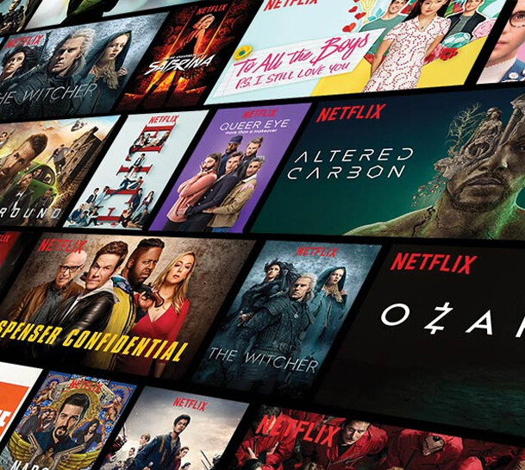
System Architecture
- Data Ingestion:
- Source: 'netflix_titles.csv'
- Preprocessing:
- Handling missing values, text vectorization using TF-IDF.
- Model Building:
- Content-Based Recommendation System.
- Sentiment Analysis.
- Clustering for Content Segmentation.
- Trend Analysis and Genre Popularity Analysis.
- Visualisation:
- Use of matplotlib and seaborn for data visualization

Slide 5
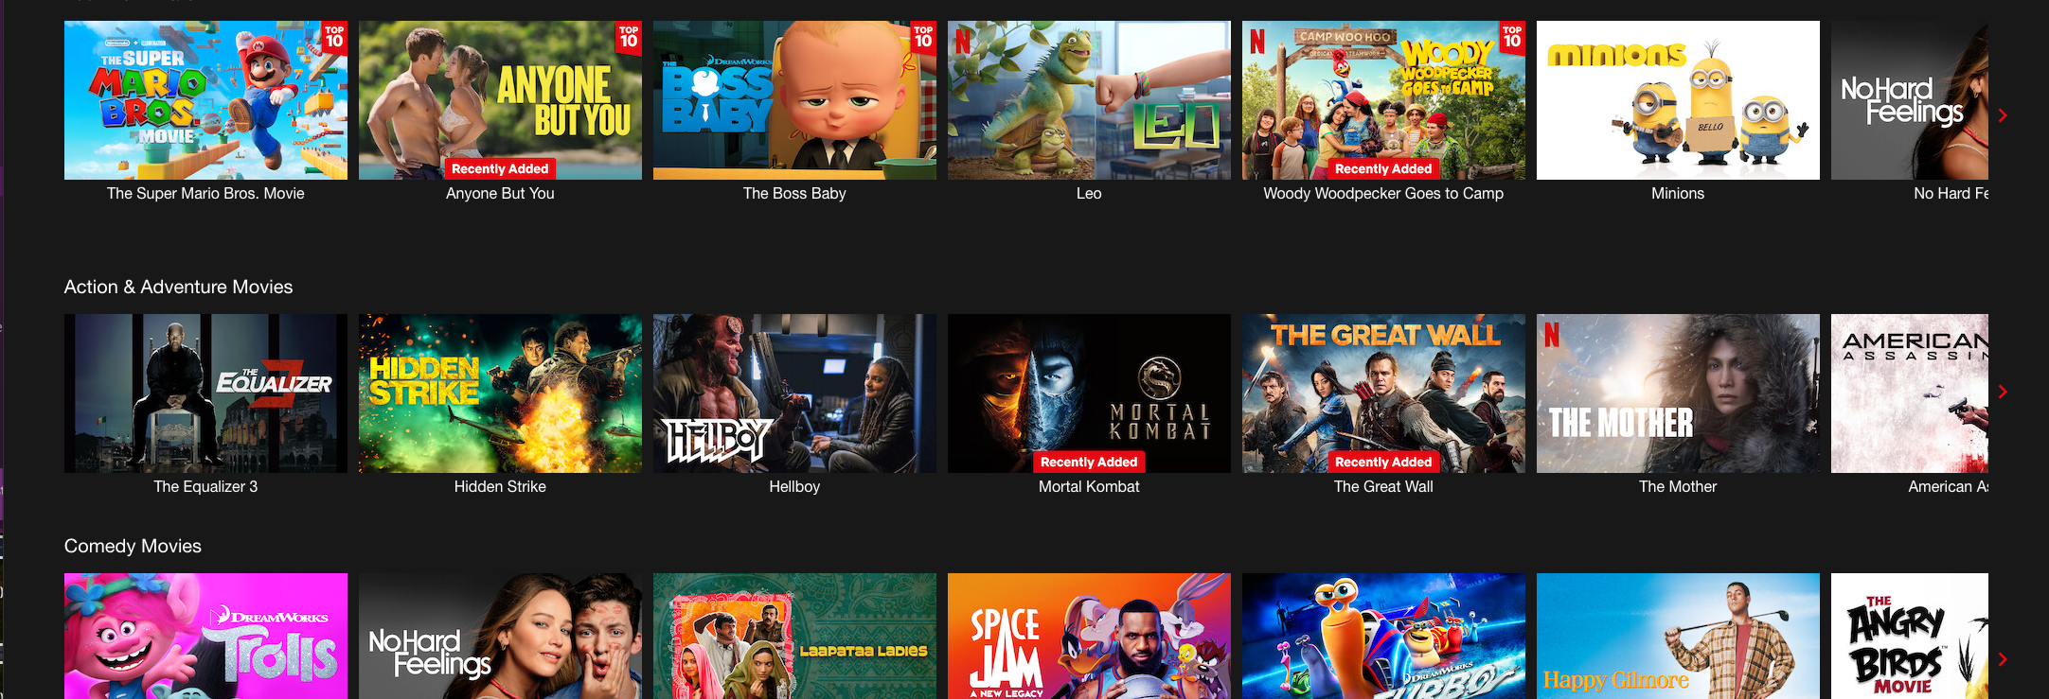
Key Implementation Steps
Data Loading and Preprocessing:
Using Pandas for data manipulation.
Handling text data with TF-IDF.
Converts text data in numerical vector by evaluating the importance of each word relative to dataset
Recommendation System:
TF-IDF vectorization and Cosine Similarity.
Consine similarity measures angle between two non-zero vectors in a multi-dimensional space
Sentiment Analysis:
TextBlob for sentiment scoring.
Provide simple APIs for common natural language processing
Clustering:
K-Means for grouping similar titles.
partitioning data points into clusters
Trend and Genre Analysis:
Time series analysis using matplotlib.
To visualise time series data

Slide 6

Model Performance Evaluation
- Recommendation System:
- Evaluated similarity scores and recommendations.
- Sentiment Analysis:
- Sentiment distribution of descriptions.
- Clustering:
- Visual inspection of clusters.
- Trend Analysis:
- Visual validation of trends over time.
- Genre Popularity:
- Trends in genre distribution over the years.

Slide 7
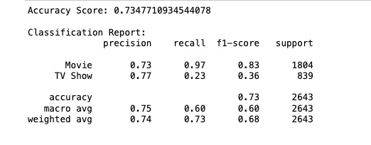
Analysis of the model performance
Evaluation
1. Overall Accuracy: The model achieves a 73.48% accuracy.
2. Strong Performance on Movies: High recall of 97% and an F1-score of 0.83 for predicting Movies.
3. Weak Performance on TV Shows: Low recall of 23% and an F1-score of 0.36 for predicting TV Shows.
4. Class Imbalance: The model is biased towards predicting Movies more accurately.
5. Future Improvement Needed: Enhancements required to improve TV Show prediction accuracy.

Slide 8
Data Visualisation
- Top 10 Titles by Popularity:
- Bar chart of the most popular titles.
- Genre Trends Over Time:
- Line plot showing genre popularity over years.
- Cluster Visualization:
- Scatter of title clusters.
- Sentiment Plot Distribution:
- Histogram of sentiment scores.

Slide 9
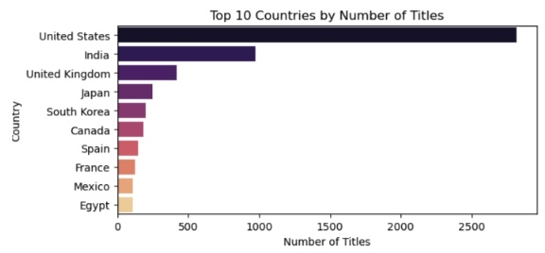
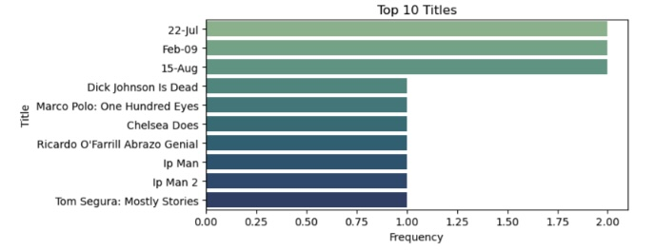
The United States has the most number of titles on Netflix
The frequency of views stands between 1-2 for the top 10 titles

Slide 10
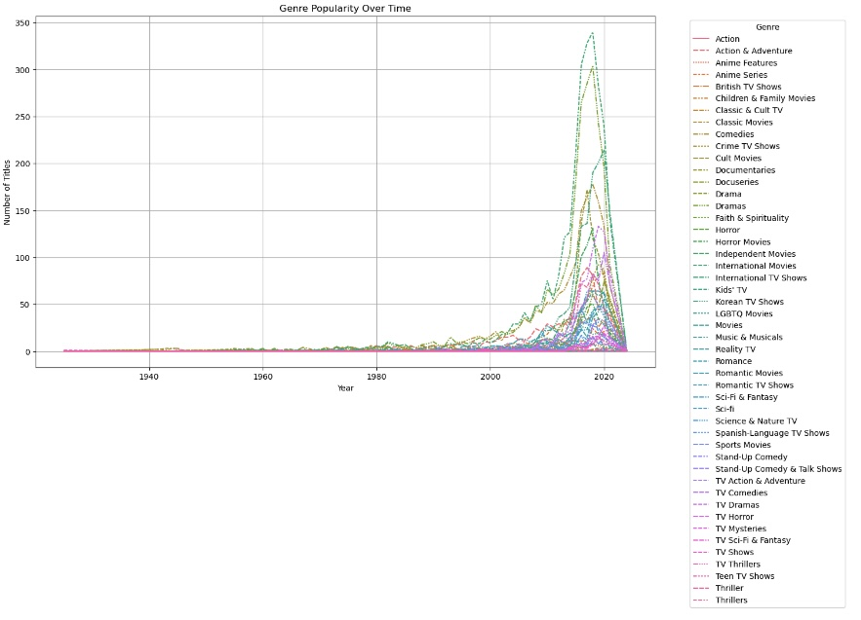
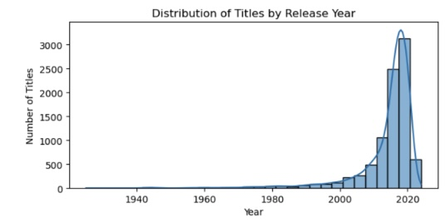
Netflix specially selects titles from recent years to suit the audience viewing diet.
Dramas stand to the most popular genre.

Slide 11
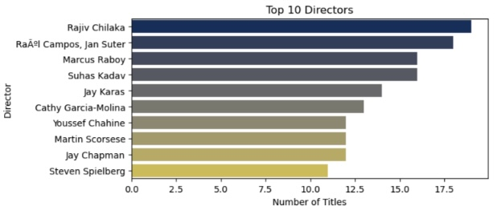
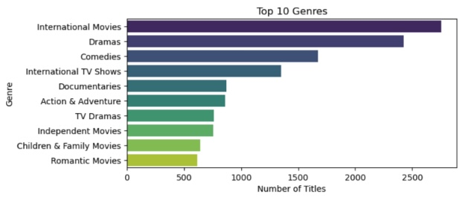
Directors delivering the most number of titles are Indian-dominated.
International movies followed by dramas rank the top 2 genres.

Slide 12
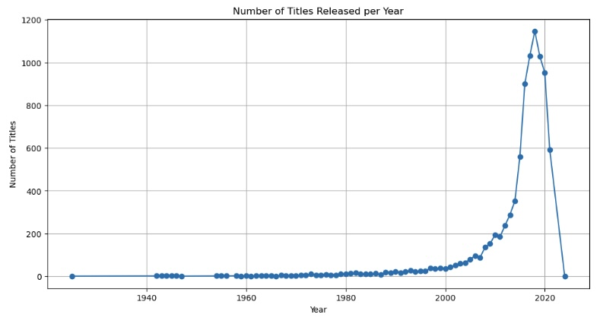
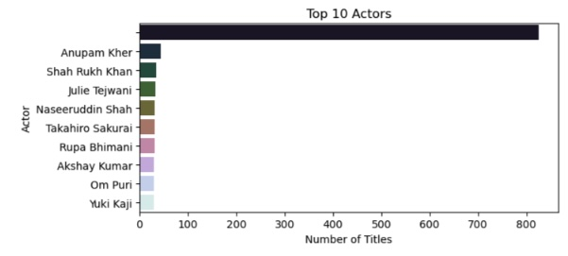
Top 10 actors delivering the most titles are from India.
2018-2019 saw the most number of titles released on Netflix.

Slide 13
Challenges and Solutions
Problem 1: Data Quality Issues:
Solution: Handled missing values and encoding errors.
Problem 2: Class Imbalance
Solution: Addressed through model selection and evaluation.
Problem 3: Feature Selection
Solution: Experimented with different features for optimal model performance.
Problem 4: Scalability
Solution: Ensured efficient processing and model training on large datasets.

Slide 14
Thank You

